Slide 1
Name: Swapnil Ghosh
Group: A2
Roll: 001911001067
TASK 18

Slide 2
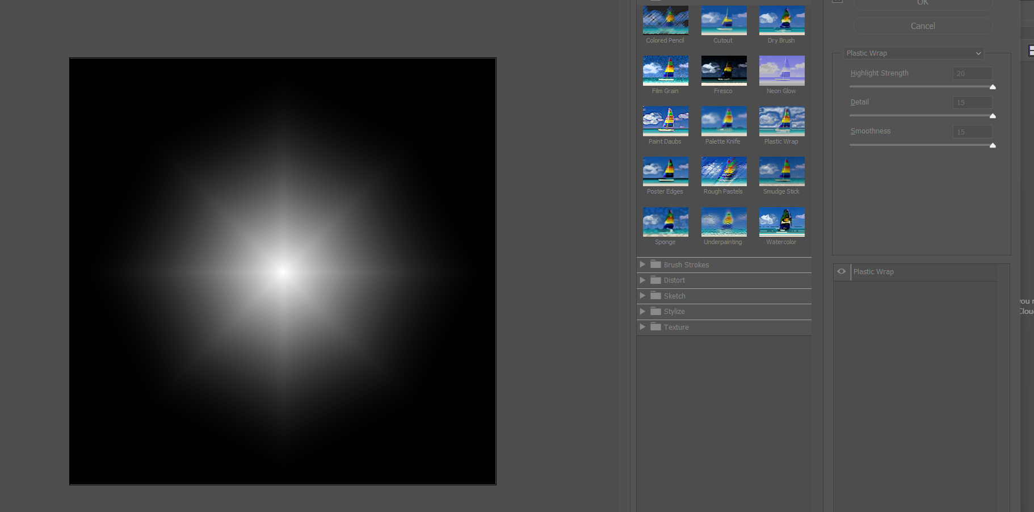
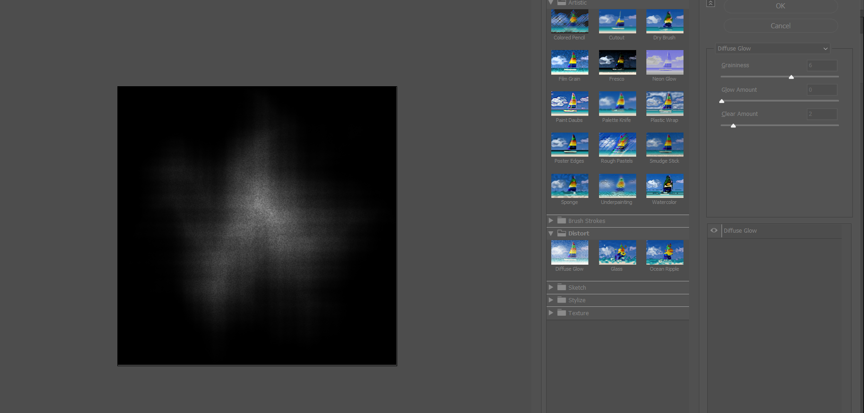
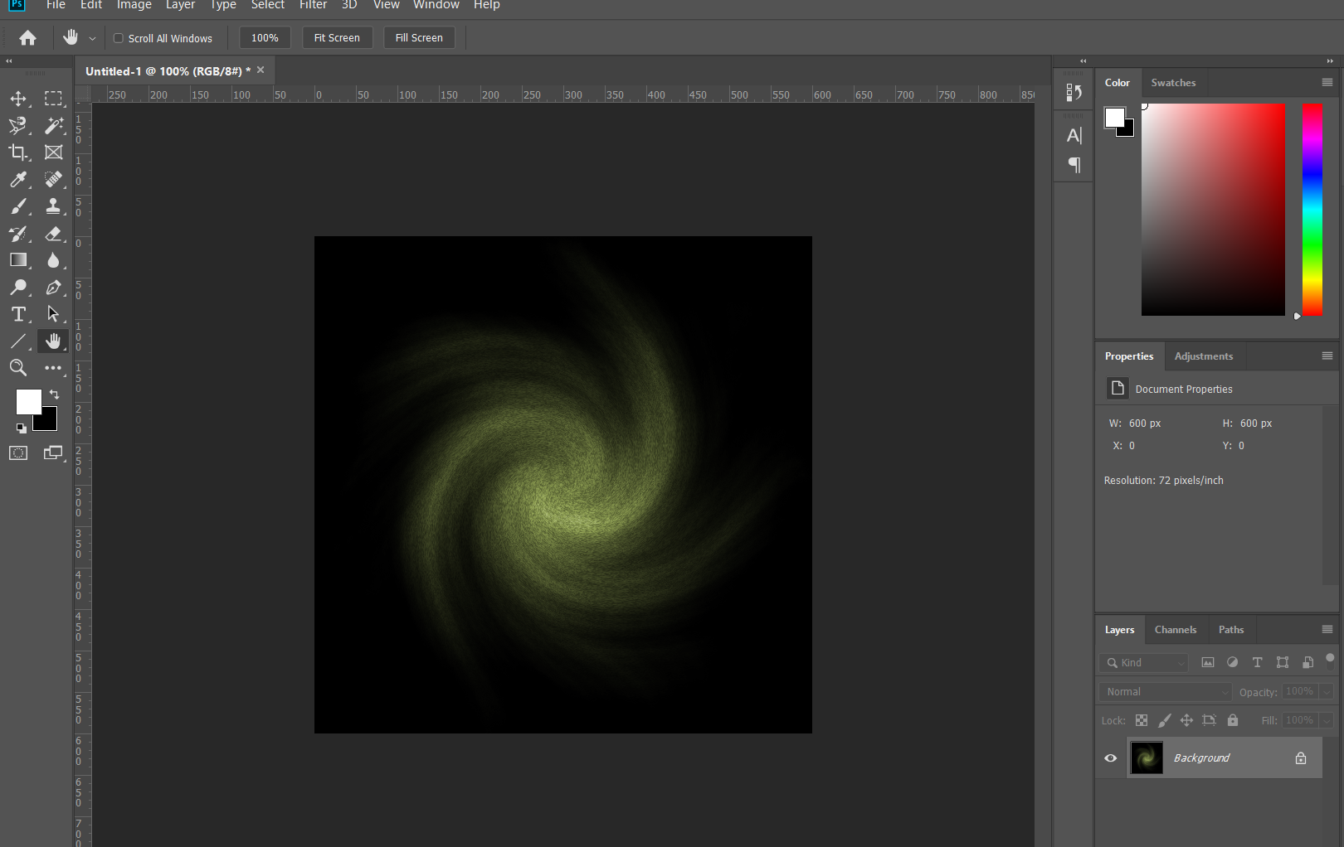
Step-1) Created a new file with dimension 600 X 600 and set the background as black and foreground colour as white.
Step-2) Choose the Filter > Artistic > Plastic Wrap with settings : 20, 15, 15.
Step-3) Choose the Filter > Distort > Wave with default settings.
Step-5) Choose the Image > Adjust > Hue Saturation with settings : Colorize, 72, 32, 0
Step-4) Choose the Filter > Distort > Diffuse Glow with settings : 6, 0, 20.
Step-6) Choose the Filter > Distort > Twirl with setting : 216.

